Slide 1




Flexsort – Calibrate Conveyor Speed
Jacob Olauson – ONT8
SORTER
DISCHARGE
INFEED
SCAN BELT
GAP BELTS

Slide 2
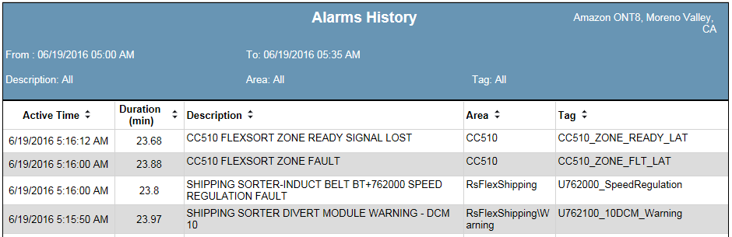
Possible Faults
These are some of the faults that may indicate that you need to Calibrate one of the conveyor speeds.
-SHIPPING SORTER-GAPPER BELT SPEED REGULATION FAULT
-SHIPPING SORTER-SCAN BELT SPEED REGULATION FAULT
-SHIPPING SORTER-INDUCT BELT SPEED REGULATION FAULT
-SHIPPING SORTER-DISCHARGE BELT SPEED REGULATION FAULT

Slide 3
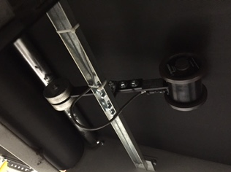
Other Reasons to Re-calibrate
-After replacing any sorter related PPIs, it is a good idea to calibrate the speed of the line for which it was changed.
-If the PPI’s poly wheels show noticeable wear, which could have changed their overall circumference.

Slide 4
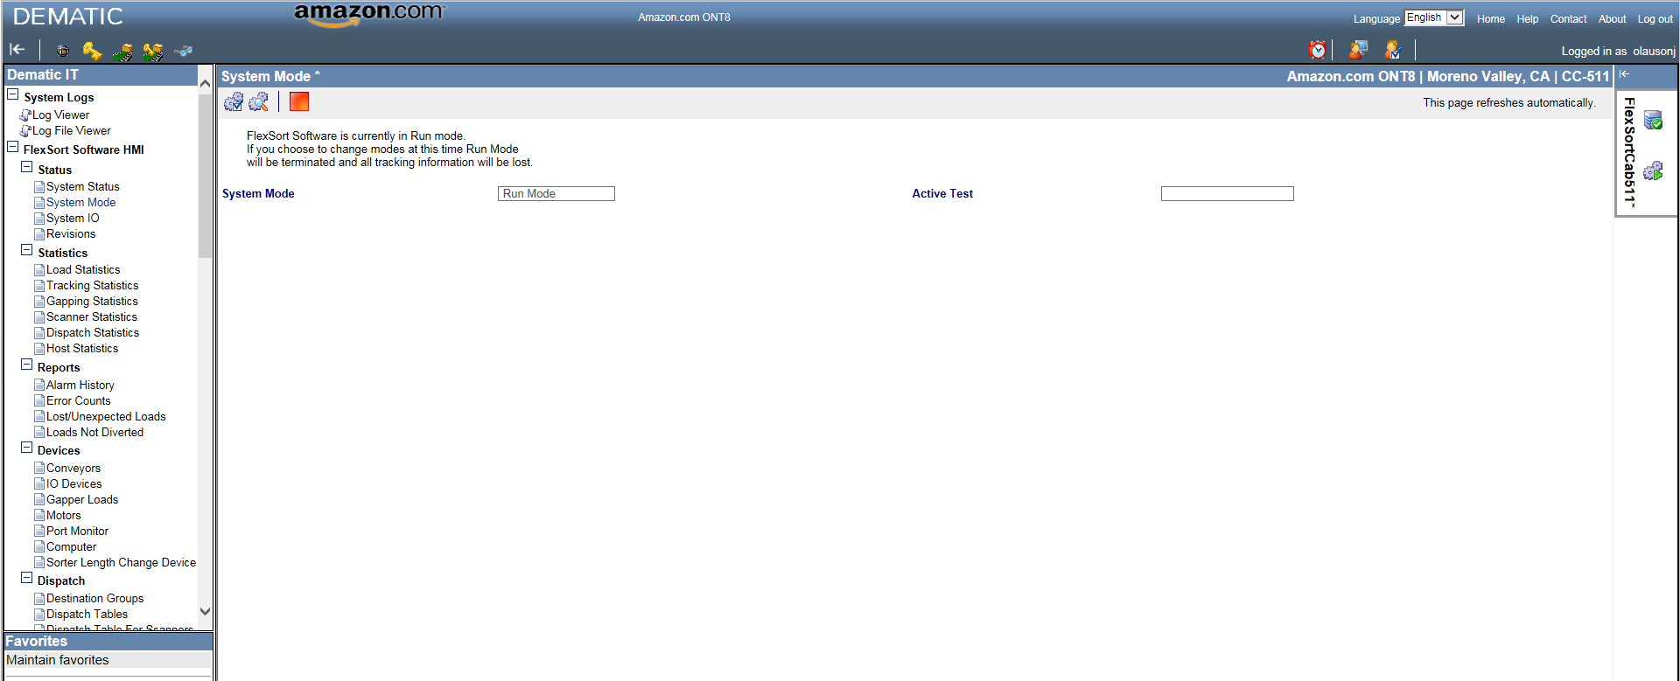
The Re-calibration Process
Step 1 – Login to Dematic IT and click on “System Mode”. NOTE: Ensure that the sorter and all related conveyance is free of cases/totes.
Step 2 – Change the System Mode to Diagnostic Mode by clicking on this symbol.
Step 3 – Confirm that you would like to enter Diagnostic Mode. NOTE: Any cases/totes left on the sorter will lose tracking data and will go to recirc once you enter Diagnostic Mode.

Slide 5
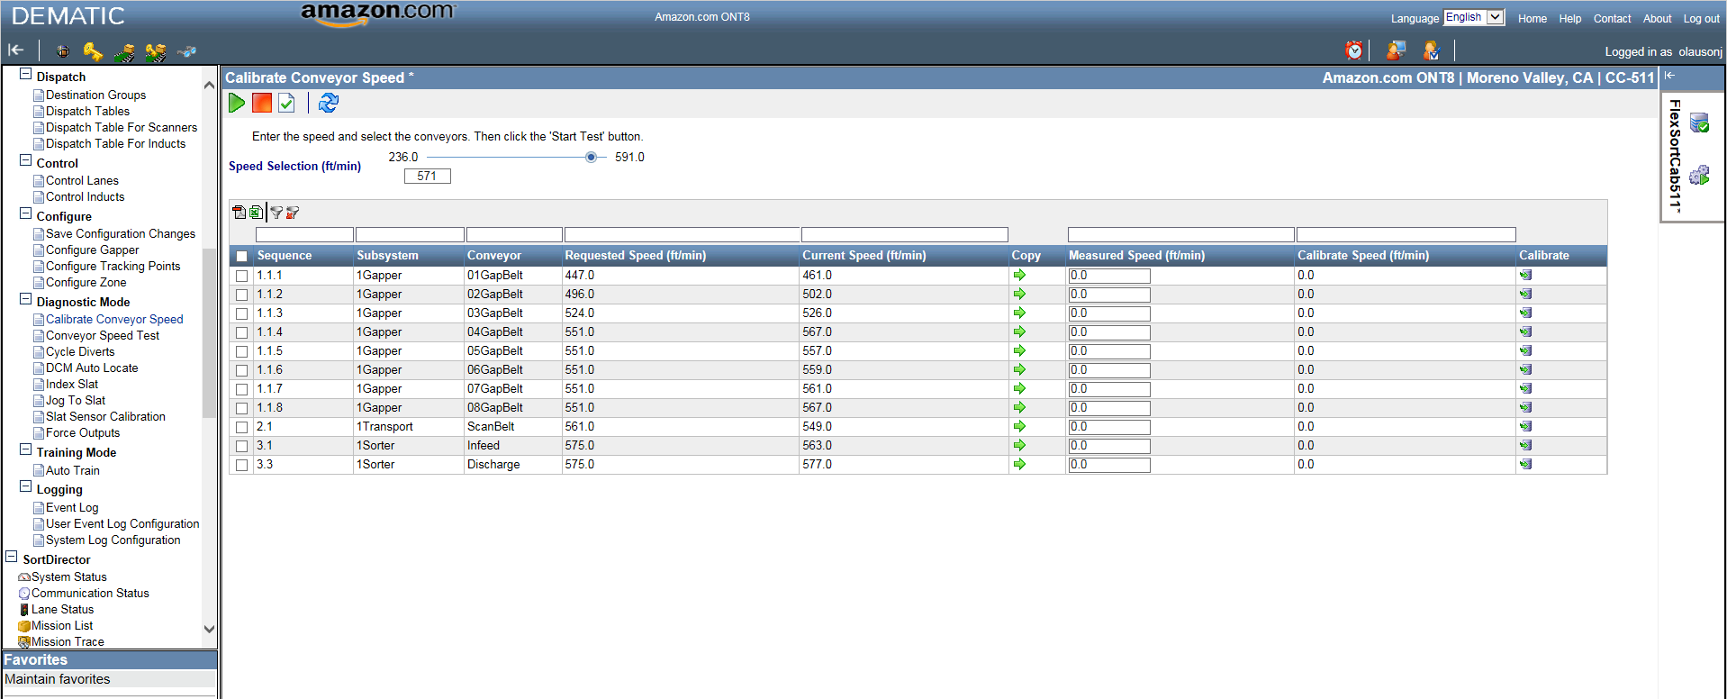
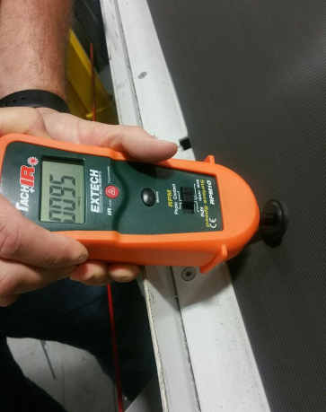
The Re-calibration Process (Cont.)
Step 4 - click on “Calibrate Conveyor Speed” in the left column.
-Step 5 – Set the Speed Selection to the maximum speed that your sorter normally runs.
-Step 6 – Select the conveyor(s) to calibrate and press PLAY. NOTE: Only the belt(s) you selected will run, so this is a good way to ensure that you are calibrating the correct line.
-Step 7 – Take a reading of the belt speed of the conveyor(s) that you would like to calibrate (in FPM) using a hand-held tachometer.

Slide 6
The Install - Controls
Step 8 – Enter the speed that the tachometer shows in the Measured Speed box for the conveyor you are recalibrating.
Step 9 – Click on the Calibrate icon adjacent to the belt you are calibrating. The controller will immediately apply the revised calibration, and the speed of the conveyor should change.
Step 10 – Check the speed of the conveyor belt using the tachometer, once again, to ensure that the newly calibrated speed matches the Requested Speed. If not, complete steps 6 through 10 again.
NOTE: Be sure to save the new configuration file and backup your spare Flexsort PC with it.

Slide 7
Questions or Concerns
For questions or concerns regarding this presentation, please feel free to reach out to…
Jacob Olauson
Control Systems Lead, ONT8
olausonj@amazon.com

